Slide 1
EQUIVALENCE RELATION: Let A be a non-empty set and R a binary relation on A. R is an equivalence relation if, and only if, R is reflexive, symmetric, and transitive. EXAMPLE: Let A = {1, 2, 3, 4} and R = {(1,1), (2,2), (2,4), (3,3), (4,2), (4,4)} be a binary relation on A. Note that R is reflexive, symmetric and transitive, hence an equivalence relation.

Slide 2
CONGRUENCES:
Let m and n be integers and d be a positive integer. The notation
m ≡ n (mod d) means that
d | (m – n) {d divides m minus n}.There exists an integer k such that
(m – n) = d ⋅ k
EXAMPLE:
c. Is 22 ≡ 1(mod 3)? b. Is –5 ≡ +10 (mod 3)?
d. Is 7 ≡ 7 (mod 3)? d. Is 14 ≡ 4 (mod 3)?
SOLUTION
a. Since 22-1 = 21 = 3⋅7.
Hence 3|(22-1), and so 22 ≡ 1 (mod 3)
b. Since – 5 – 10 = - 15 = 3 ⋅ (-5),
Hence 3|((-5)-10), and so - 5 ≡ 10 (mod 3)
c. Since 7 – 7 = 0 = 3 ⋅ 0
Hence 3|(7-7), and so 7 ≡ 7 (mod 3)
d. Since 14 – 4 = 10, and 3 / 10 because 10 ≠ 3⋅ k for any integer
k. Hence 14 ≡ 4 (mod 3).

Slide 3
EXERCISE: Define a relation R on the set of all integers Z as follows: for all integers m and n, m R n ⇔ m ≡ n (mod 3) Prove that R is an equivalence relation.
SOLUTION:
R is reflexive. R is reflexive iff for all m ∈Z, m R m.
By definition of R, this means that,
For all m ∈Z, m ≡ m (mod 3)
Since m – m = 0 = 3 ⋅0. Hence 3|(m-m), and so m ≡ m (mod 3)
mRm ⇒ R is reflexive.
R is transitive. R is transitive iff for all m, n, p ∈Z, if mRn and nRp then mRp
Now mRn and nRp means m ≡ n (mod 3) and n ≡ p (mod 3)
3|(m-n) and 3|(n-p)
(m-n) = 3r and (n-p) = 3s for some r, s ∈Z
Adding these two equations, we get,
(m – n) + (n – p) = 3 r + 3 s
m – p = 3 (r + s),where r + s ∈Z
3|(m – p)
m ≡ p (mod 3) ⇔ m Rp
Hence R is transitive. R being reflexive, symmetric and transitive, is an
equivalence relation.
R is symmetric. R is symmetric iff for all m, n ∈Z
if m R n then n R m. Now mRn
⇒ m≡n (mod 3)
⇒ 3|(m-n)
⇒ m-n = 3k, for some integer k.
⇒ n – m = 3(-k), -k ∈Z
⇒ 3|(n-m)
⇒ n ≡ m (mod 3)
⇒ nRm, Hence R is symmetric.

Slide 4
Matrix Representation of Relations We have Represent all the types of relations in Matrix
COMPOSITE RELATION:
Let R be a relation from a set A to a set B and S a relation from B to a set C.
The composite of R and S denoted SoR is the relation from A to C, consisting of ordered pairs (a,c) where a ∈A, c ∈C, and for which there exists an element b ∈B such that (a,b) ∈R and (b,c) ∈S.
Symbolically:
SoR = {(a,c)|a ∈A, c ∈C,∃ b ∈B, (a,b) ∈R and (b,c) ∈S}

Slide 5
EXAMPLE:
Define R = {(a,1), (a,4), (b,3),(c,1), (c,4)} as a relation from A to B
and S = {(1,x),(2,x), (3,y), (3,z)} be a relation from B to C.
Hence
SoR = {(a,x), (b,y), (b,z), (c,x)}

Slide 6
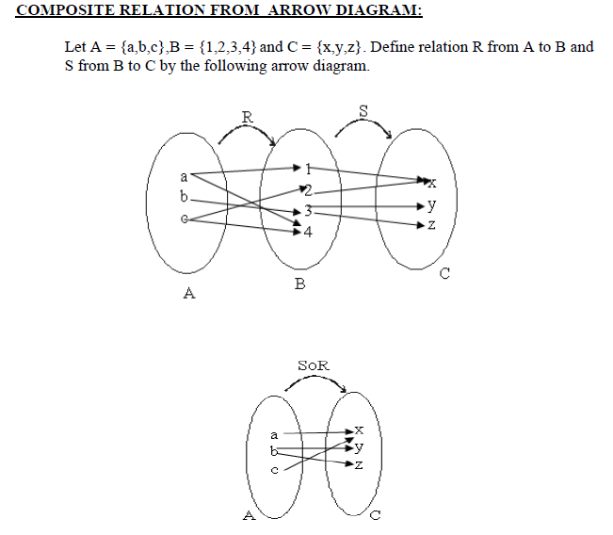

Slide 7
MATRIX REPRESENTATION OF COMPOSITE RELATION:
The matrix representation of the composite relation can be found using the
Boolean product of the matrices for the relations. Thus if MR and MS are the
matrices for relations R (from A to B) and S (from B to C), then
MSoR = MR OMS
is the matrix for the composite relation SoR from A to C.
BOOLEAN BOOLEAN
ADDITION MULTIPLICATION
a. 1 + 1 = 1 a. 1 . 1 = 1
b. 1 + 0 = 1 b. 1 . 0 = 0
c. 0 + 0 = 0 c. 0 . 0 = 0

Slide 8
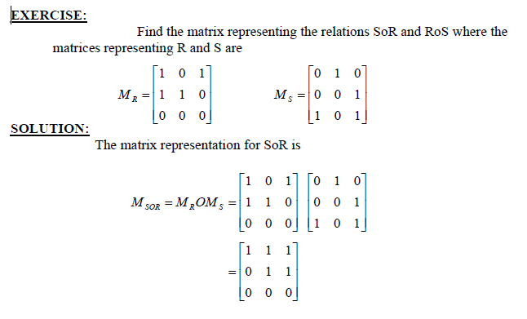

Slide 9
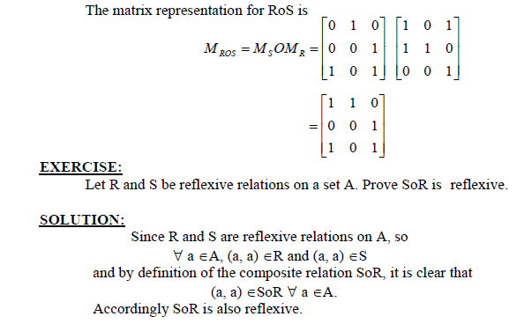

Slide 10
Functions
RELATIONS AND FUNCTIONS:
A function F from a set X to a set Y is a relation from X to Y that satisfies the following
two properties
1. For every element x in X, there is an element y in Y such that (x,y) ∈F.
In other words every element of X is the first element of some ordered pair of F.
2. For all elements x in X and y and z in Y, if (x,y) ∈F and (x,z) ∈F, then y = z
In other words no two distinct ordered pairs in F have the same first element.

Slide 11
EXERCISE:
Which of the relations define functions from X = {2,4,5} to Y={1,2,4,6}.
a. R1 = {(2,4), (4,1)}
b. R2 = {(2,4), (4,1), (4,2), (5,6)}
c. R3 = {(2,4), (4,1), (5,6)}
SOLUTION :
a. R1 is not a function, because 5 ∈X does not appear as the first element in any ordered pair in R1.
b. R2 is not a function, because the ordered pairs (4,1) and (4,2) have the same first element but different second elements.
c. R3 defines a function because it satisfy both the conditions of the function that is every element of X is the first element of some order pair and there is no pair which has the same first order pair but different second order pair.

Slide 12
EXERCISE:
Let A = {4,5,6} and B = {5,6} and define binary relations R and S from A to B as
follows:
for all (x,y) ∈A ⋅ B, (x,y) ∈ R ⇔ x≥y
for all (x,y) ∈A ⋅ B, xSy ⇔ 2|(x-y)
a. Represent R and S as a set of ordered pairs.
b. Indicate whether R or S is a function
SOLUTION:
a. Since we are given the relation R contains those order pairs of A ⋅ B which has their first element greater or equal to the second Hence R contains the order pairs.
R = {(5,5), (6,5), (6,6)}
Similarly S is such a relation which consists of those order pairs for which the difference of first and second elements difference divisible by 2.
Hence S = {(4,6), (5,5), (6,6)}
b. R is not a function because 4 ∈A is not related to any element of B.
S clearly defines a function since each element of A is related to a unique element of B.

Slide 13
FUNCTION:
A function f from a set X to a set Y is a relationship between elements of X and elements of Y such that each element of X is related to a unique element of Y, and is denoted
f : X →Y. The set X is called the domain of f and Y is called the co-domain of f.
NOTE: The unique element y of Y that is related to x by f is denoted f(x) and is called f of x, or the value of f at x, or the image of x under f
ARROW DIAGRAM OF A FUNCTION:
The definition of a function implies that the arrow diagram for a function f has the
following two properties:
1. Every element of X has an arrow coming out of it
2. No two elements of X has two arrows coming out of it that point to two different
elements of Y.

Slide 14
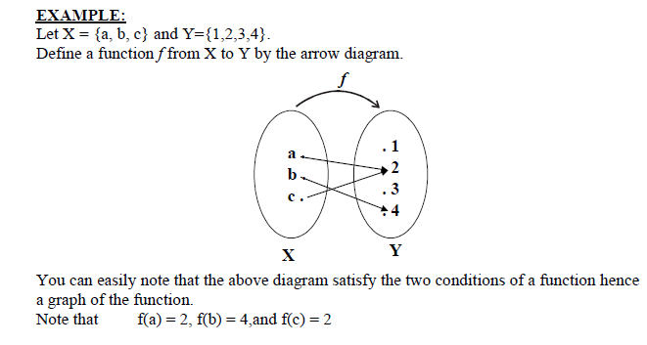

Slide 15
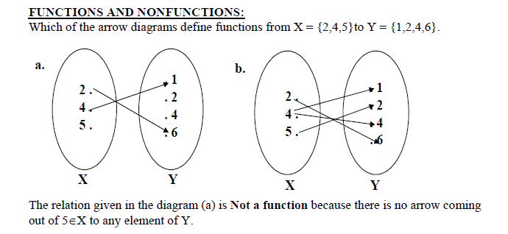
The relation in the diagram (b) is Not a function, because there are two arrows coming
out of 4∈X. i.e.,4∈X is not related to a unique element of Y.

Slide 16
RANGE OF A FUNCTION:
Let f: X→Y. The range of f consists of those elements of Y that are image of
elements of X.
Symbolically,
Range of f = {y ∈Y| y = f(x), for some x ∈X}
NOTE:
1. The range of a function f is always a subset of the co-domain of f.
2. The range of f: X →Y is also called the image of X under f.
3. When y = f(x), then x is called the pre-image of y.
4. The set of all elements of X, that are related to some y ∈Y is called the inverse image of y.

Slide 17
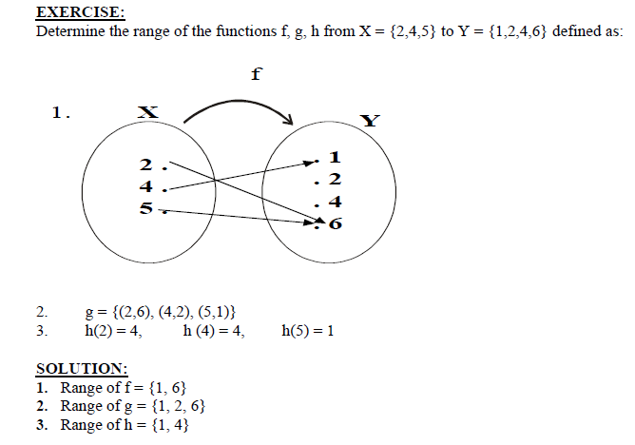

Slide 18
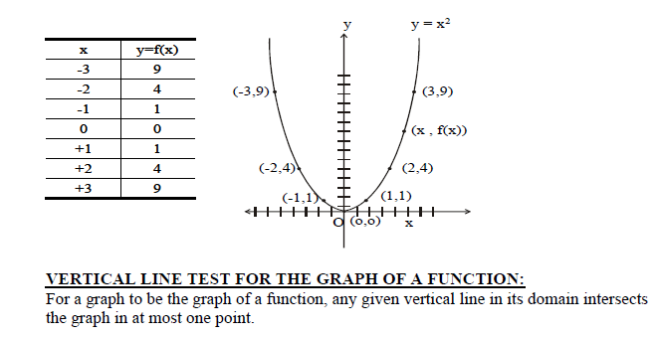
GRAPH OF A FUNCTION:
Let f be a real-valued function of a real variable. i.e. f:R →R. The graph of f is the set of all points (x,y) in the Cartesian coordinate plane with the property that x is in the domain of f and y = f(x).
EXAMPLE:
We have to draw the graph of the function f given by the relation y=x2 in order to draw the graph of the function we will first take some elements from the domain will see the image of them and then plot then on the graph as follows
Graph of y = x2

Slide 19
Types of functions, Lecture No.6

